Slide 1
Mini Project-3
Kiran Gavini
16227237

Slide 2
TASK1(TDNN)
Hidden Layers | Delay | EER | Area | Decidability
3 | 10 | 0.008333 | 0.99917 | 3.3678
3 | 15 | 0.05 | 0.99292 | 2.8413
3 | 20 | 0.05833 | 0.9775 | 2.7455
5 | 10 | 0 | 1 | 4.2623
5 | 15 | 0.05 | 0.9933 | 3.3524
5 | 20 | 0.05 | 0.99333 | 2.915
10 | 10 | 0 | 1 | 4.8794
10 | 15 | 0.00833 | 0.9975 | 4.1697
10 | 20 | 0.05 | 0.9925 | 3.285

Slide 3

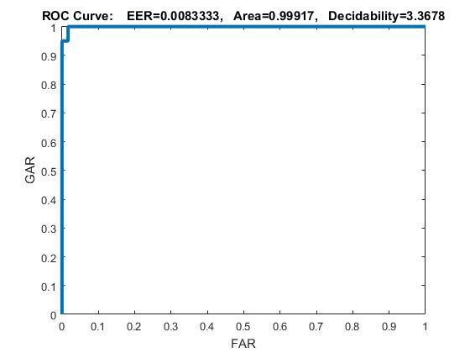
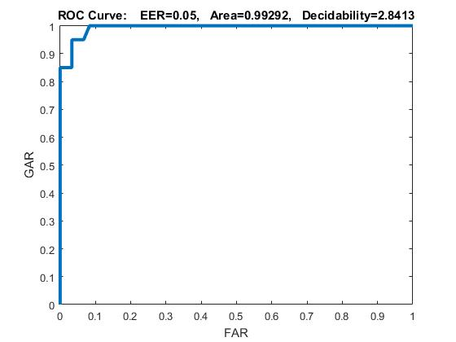

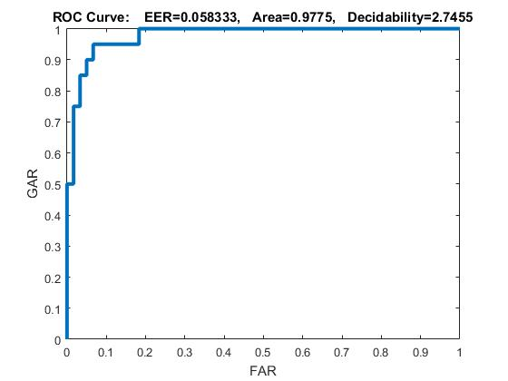

.

Slide 4

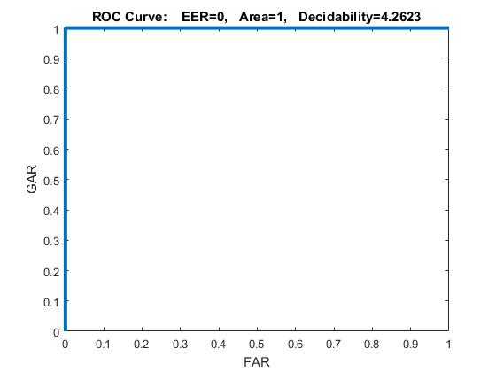


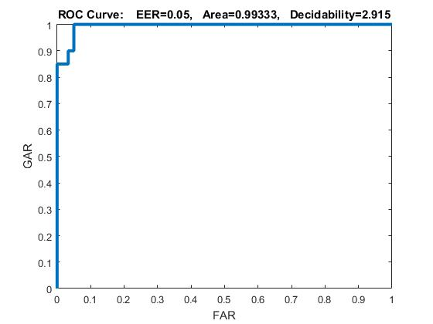


Slide 5


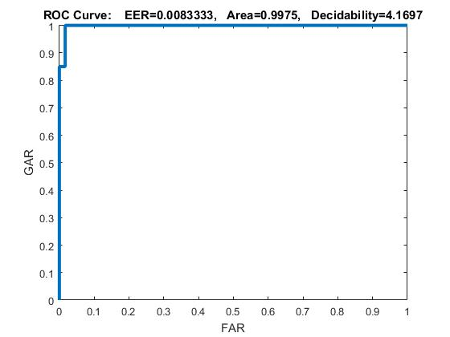


Slide 6
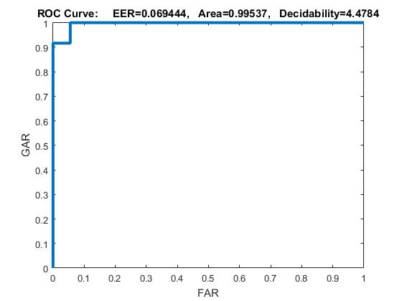
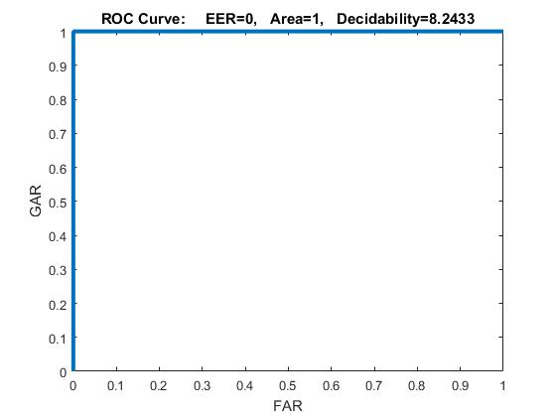
SUBJECT SPECIFIC TDNN

Slide 7

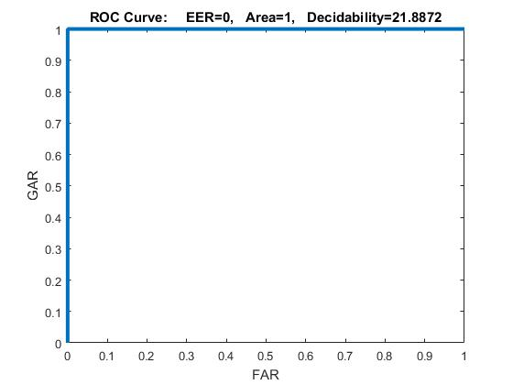

Slide 8
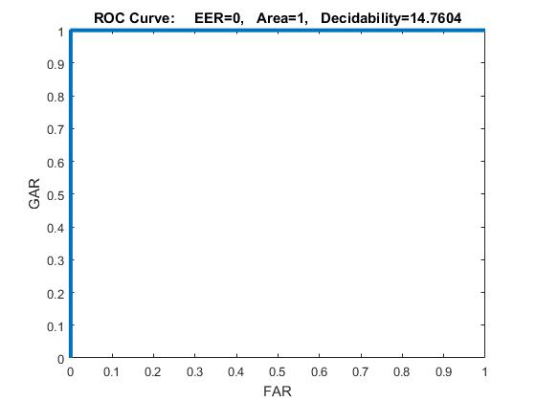
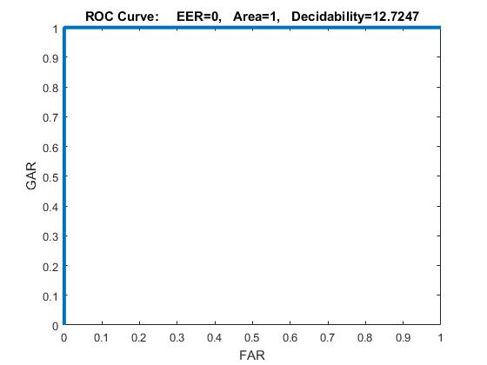

Slide 9
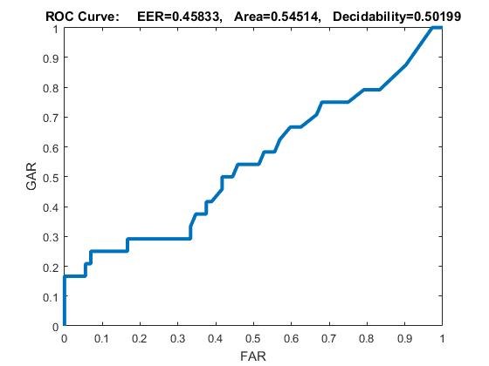
Subject Independent(TDNN)

Slide 10
NARX net(Configuration)
N1 | N2 | H | EER | AREA
10 | 9 | 5 | 0.29167 | 0.85167
10 | 8 | 5 | 0.175 | 0.90417
10 | 5 | 5 | 0.24 | 0.87161
11 | 9 | 7 | 0.2 | 0.9
11 | 8 | 7 | 0.3 | 0.8358
11 | 5 | 7 | 0.25 | 0.85833
10 | 9 | 7 | 0.108 | 0.889
10 | 8 | 7 | 0.158 | 0.86
10 | 5 | 7 | 0.24 | 0.89
11 | 9 | 5 | 0.24167 | 0.84208
11 | 8 | 5 | 0.125 | 0.879
11 | 5 | 5 | 0.1667 | 0.89917

Slide 11

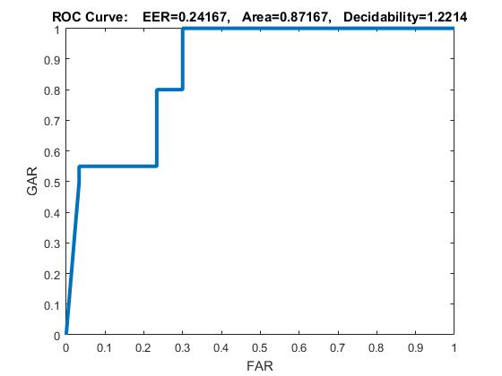
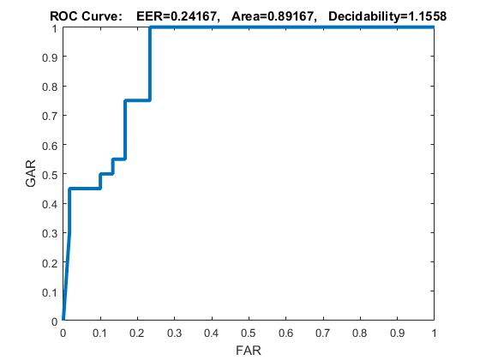
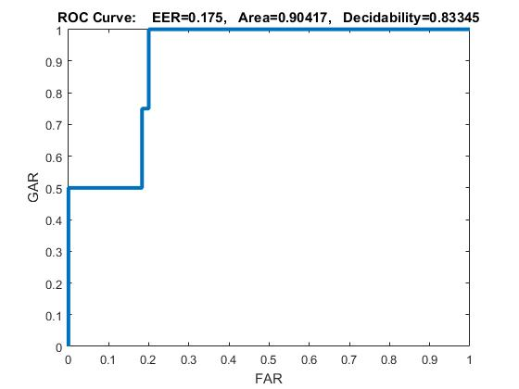
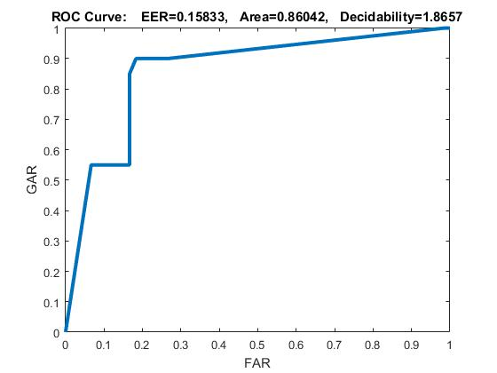

Slide 12

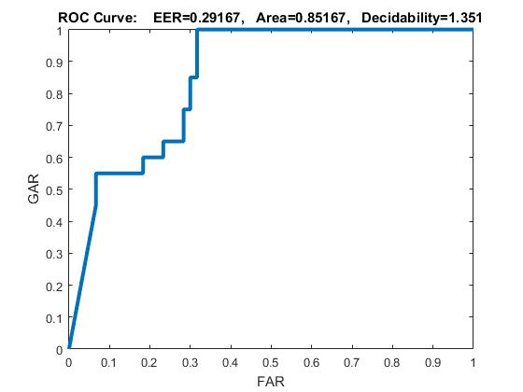
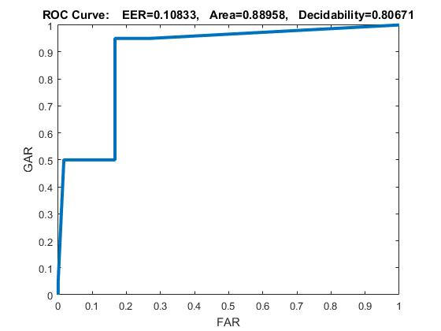
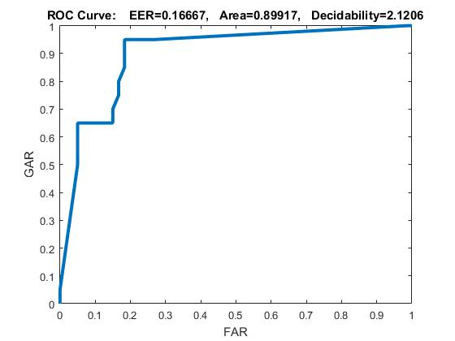
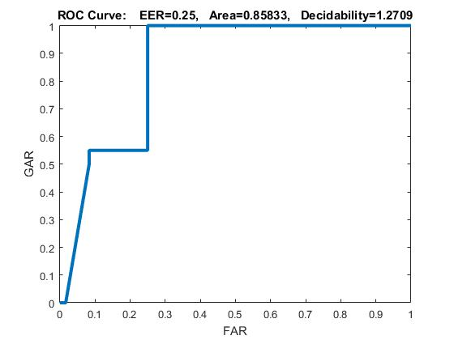

Slide 13
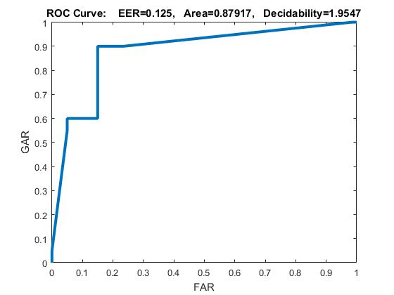
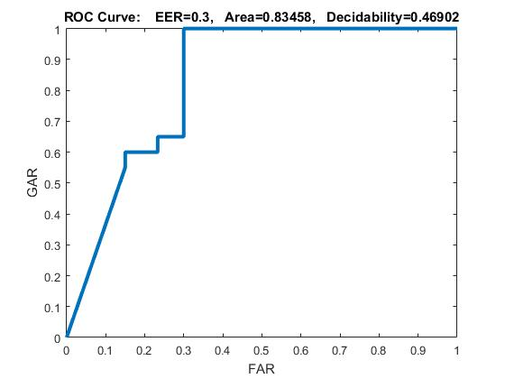

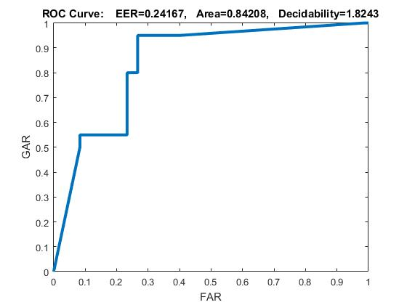
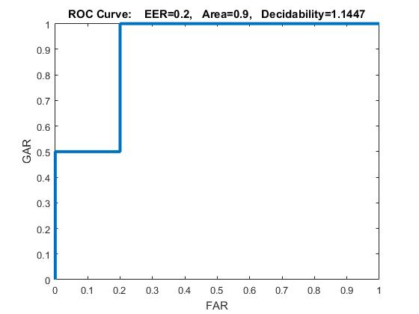

Slide 14
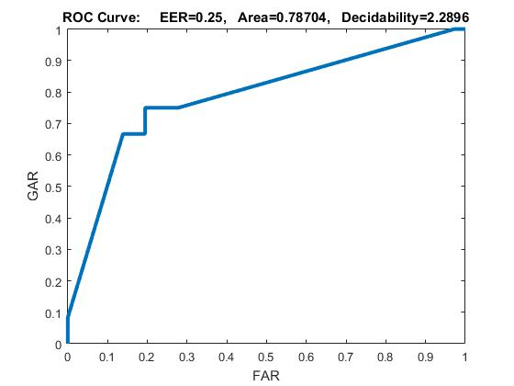
NARX(SUBJECT Dependant)

Slide 15
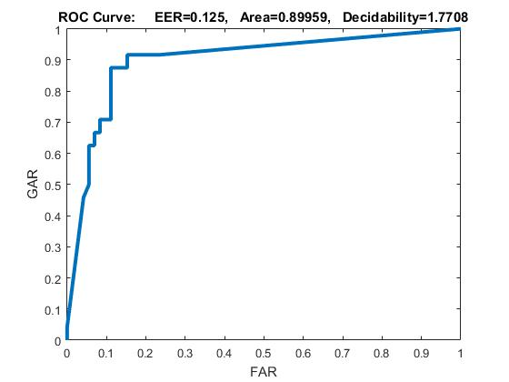
NARX(Subject IndePendent)

